Slide 1
Smart Cities Concept
Broker Redundancy

Slide 2
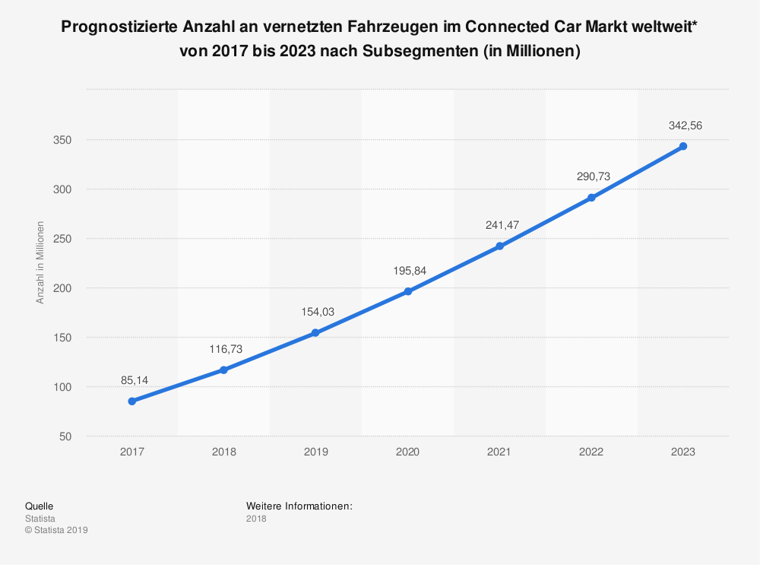
Motivation
connected vehicles in smart cities
transmission of vehicle data
data is important for external services
prevent data loss when the connection is broken
https://de.statista.com/statistik/daten/studie/893915/umfrage/connected-car-anzahl-der-fahrzeuge-weltweit/
Notes:
Standortbezogene Dienste
Online Diagnose von Werkstätten
Sammeln von wetterdaten, fahrzeuge als wetterstationen
Mobile arbeitszeiterfassung
Relevatne daten für rettungsdienste

Slide 3
Requirements
ID | Name | Type
A | detect disconnections | functional
A.1 | store data until reconnect | functional
B | local MQTT broker | Non-functional
C | All data guarantee | functional
D | Use MQTT | Non-functional
E | Send stored data after reconnection | functional
F | Vehicle can register with the smart city server. | functional
G | Send ermergency calls to the server | functional

Slide 4


Concept
Local MQTT broker collects all sensor data
Publishes the data to the online broker
Smart City
Online Broker
subscribe
Server
publish
Auto
publish
subscribe
Lokaler Broker
publish
Sensor

Slide 5
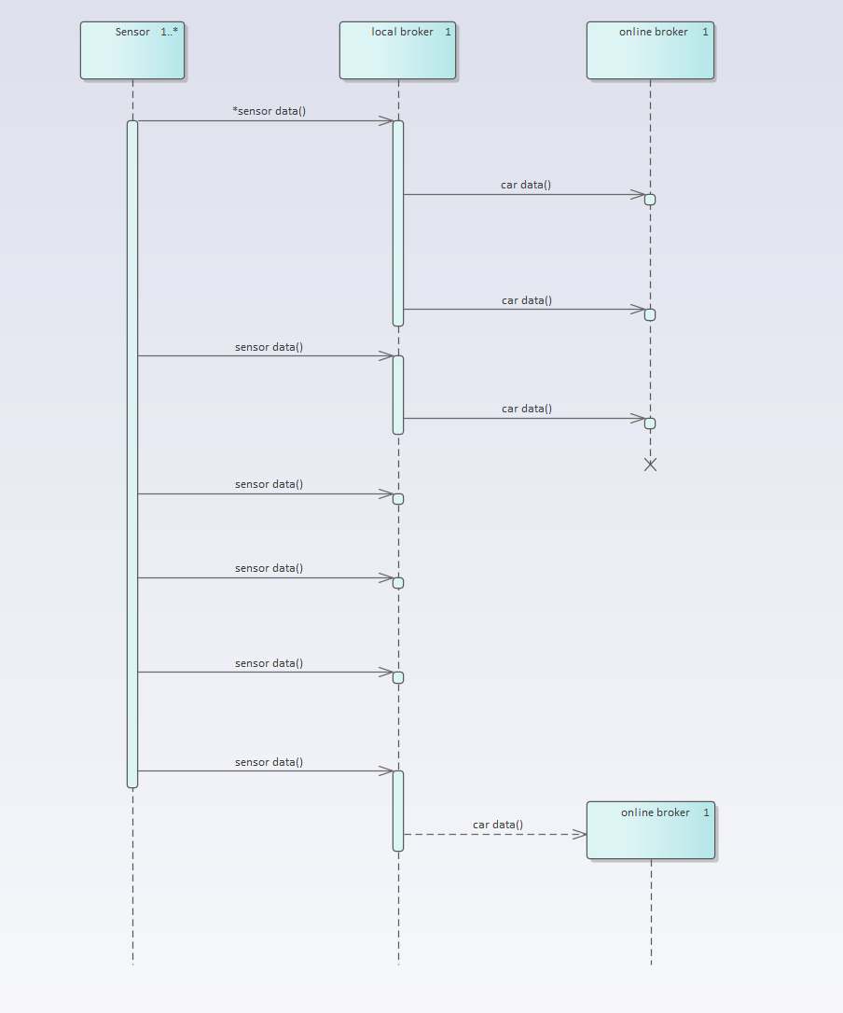
Sequence Diagram
the sensor publishes its data every three seconds
the local broker passes the data on every 8 seconds
If the connection is broken, the data is saved in the local broker
after reconnect all stored data are transferred

Slide 6
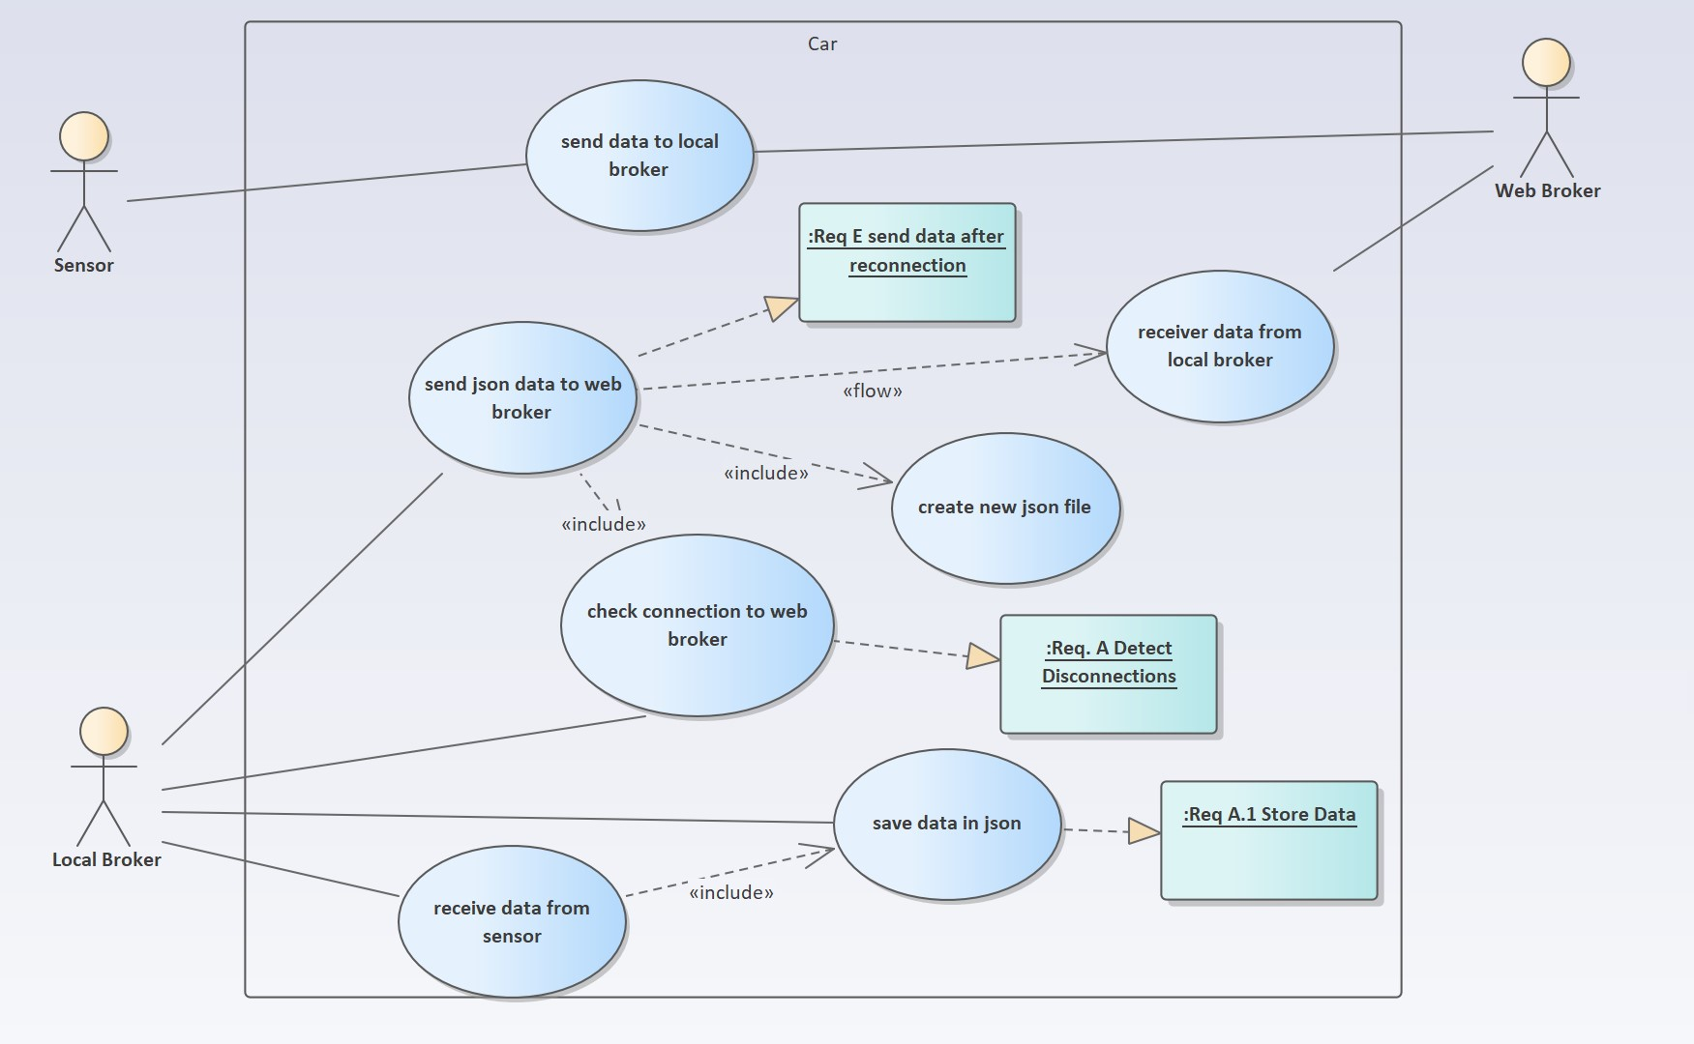
Use CaseDiagram

Slide 7
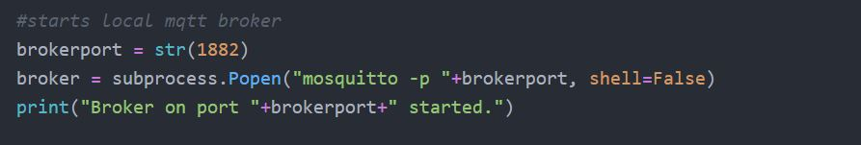
Setup Local Broker
Mosquitto broker
Requirement B

Slide 8
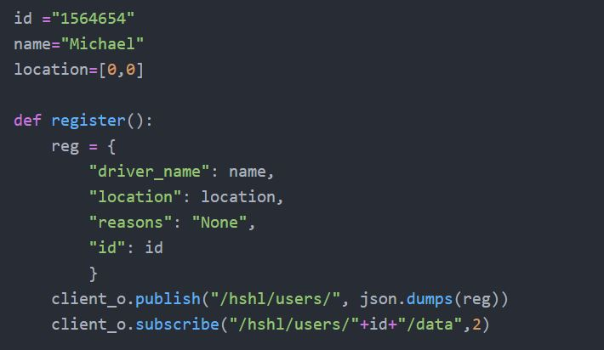
Register to Server
Requirement F

Slide 9
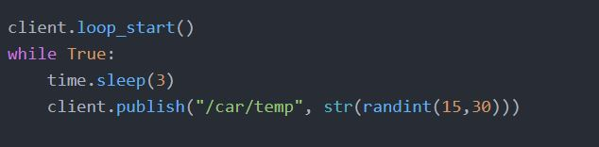
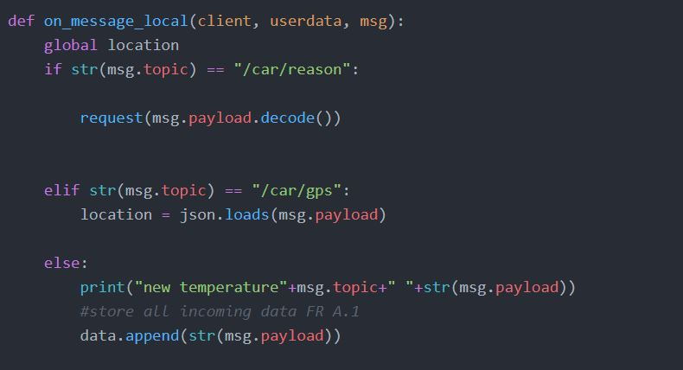
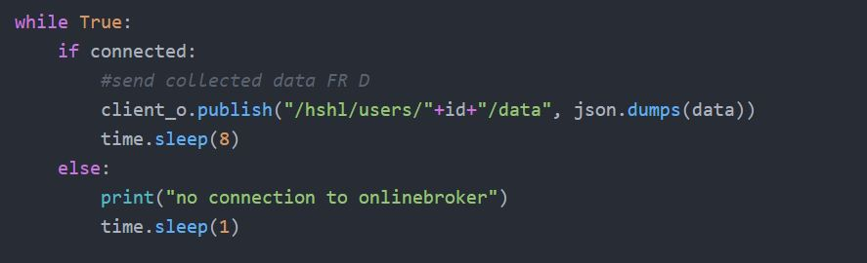
Data Transmission
Random temperatures
Requirement A.1
Save temperature data
Send data in case of connection

Slide 10
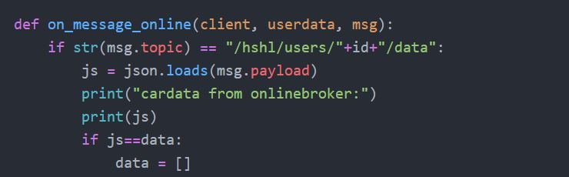
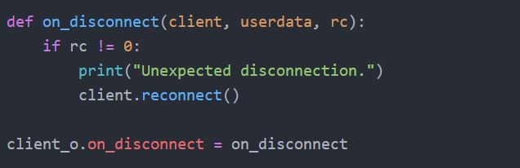
Guarantee Data Transmission
Only reset data if the transfer was successful
Requirement C
Requirement A

Slide 11
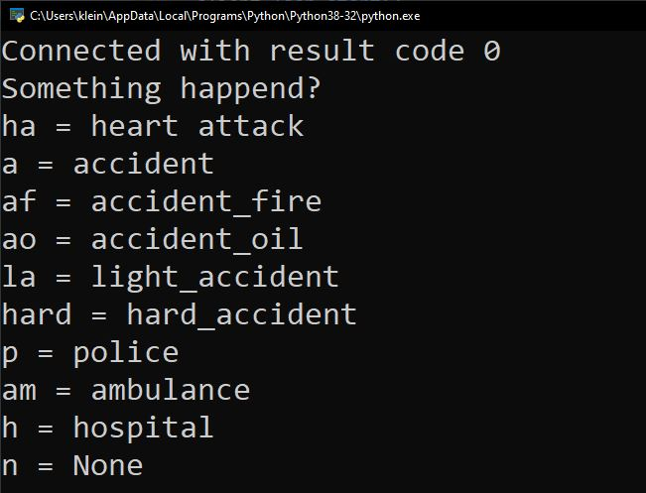
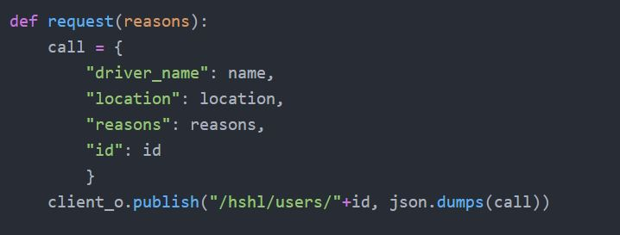
Emergency Calls
Requirement G

Slide 12
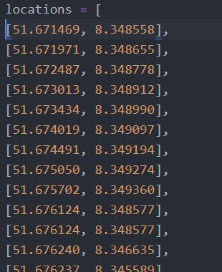
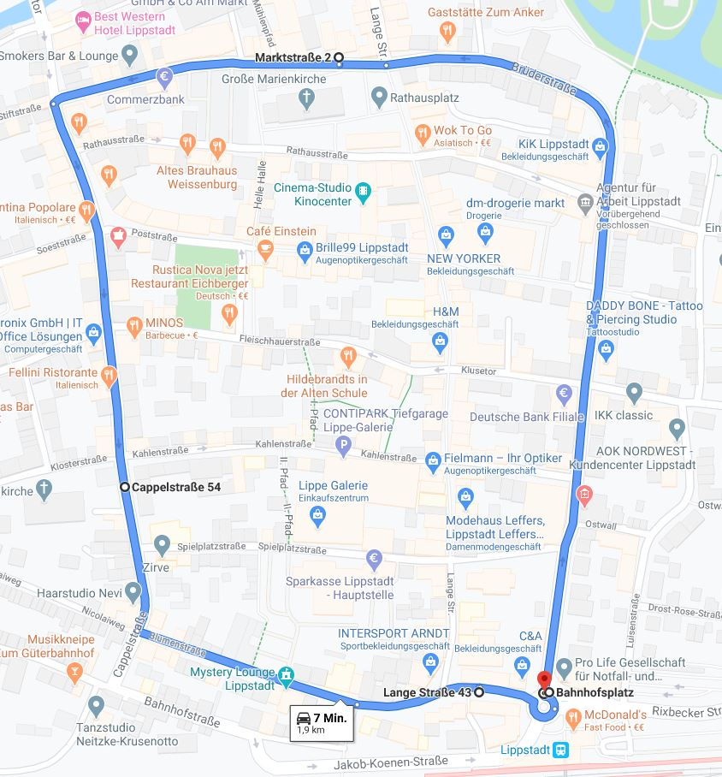
Positions

Slide 13
Conclusion and Results
working concept
data structure could be improved
data security should be improved (encryption)
ID | Name | Type | fulfilled
A | detect disconnections | functional | x
A.1 | store data until reconnect | functional | x
B | local MQTT broker | Non-functional | x
C | All data guarantee | functional | x
D | Use MQTT | Non-functional | x
E | Send stored data after reconnection | functional | x
F | Vehicle can register with the smart city server. | functional | x
G | Send ermergency calls to the server | functional | x

